Slide 1

Diamond Price Prediction
Understanding Controls on Diamond Price and Diamond Price Prediction

Slide 2
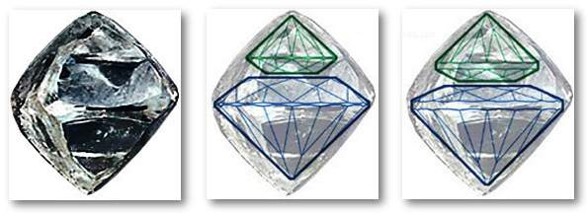
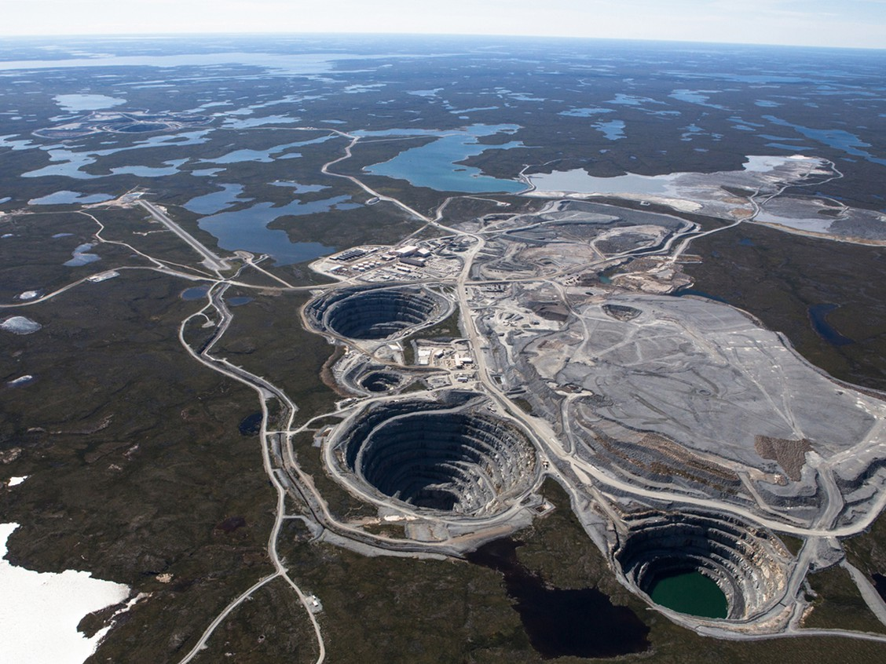
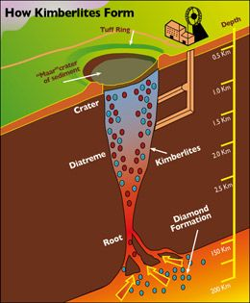
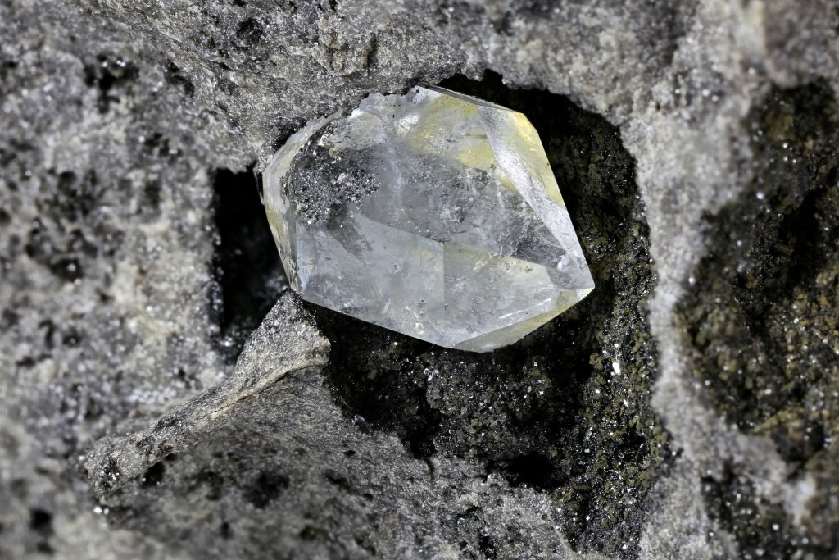
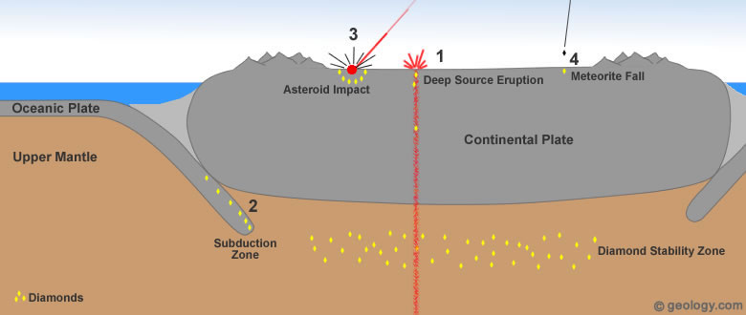
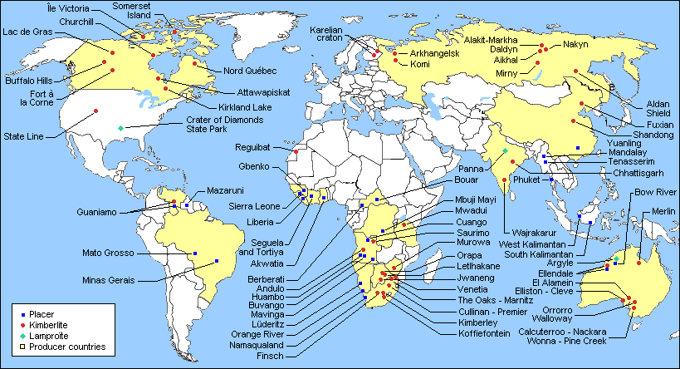
Diamond Genesis
Diamonds created billions of years ago
Brought to surface through deep source eruptions
Mined in open pits, diamonds come out ‘rough’
Diamonds are cut into desired shape

Slide 3
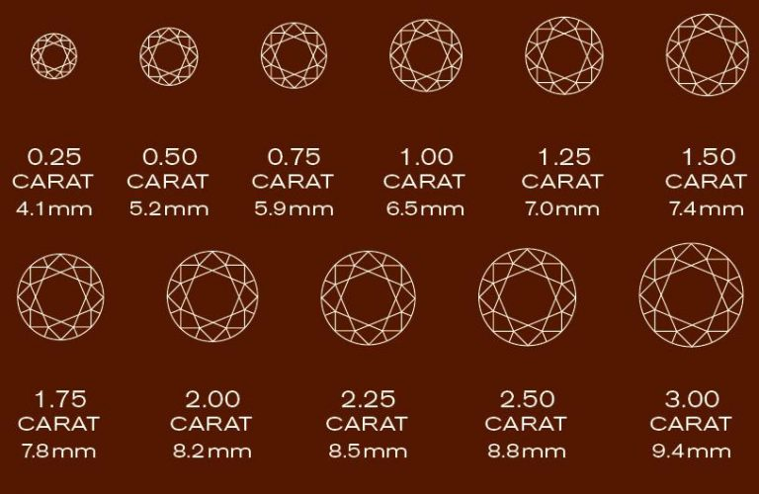
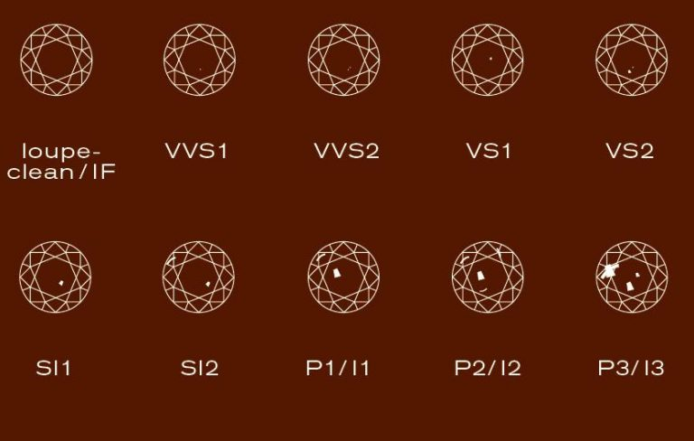
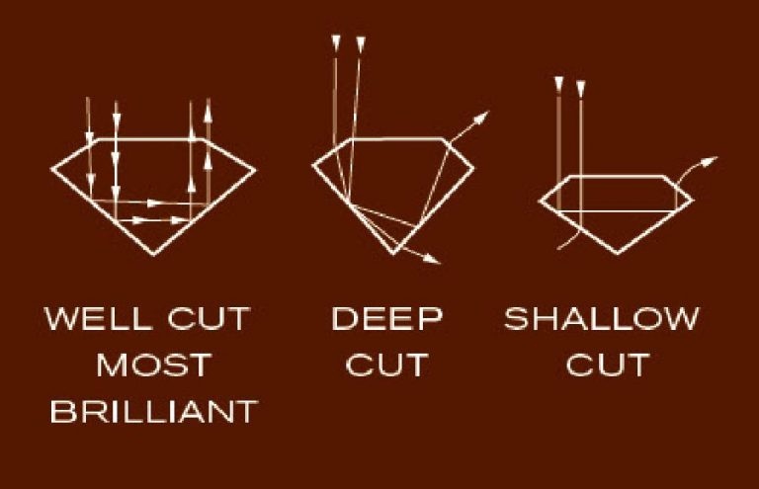
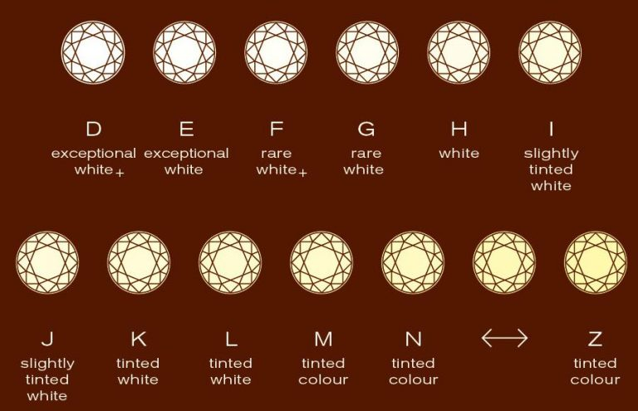
The “Four C’s” of Diamond Quality
Carat
Clarity
Cut
Colour

Slide 4
Objectives
Understand controls on diamond pricing
Identifying any significant outliers in size or symmetry
Create a model to predict diamond price
Evaluate revenue impacts for a diamond retailer

Slide 5
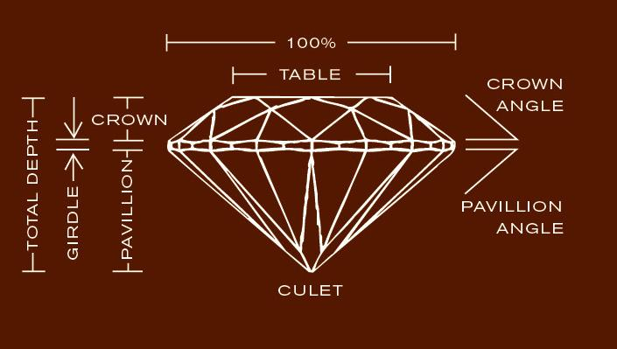
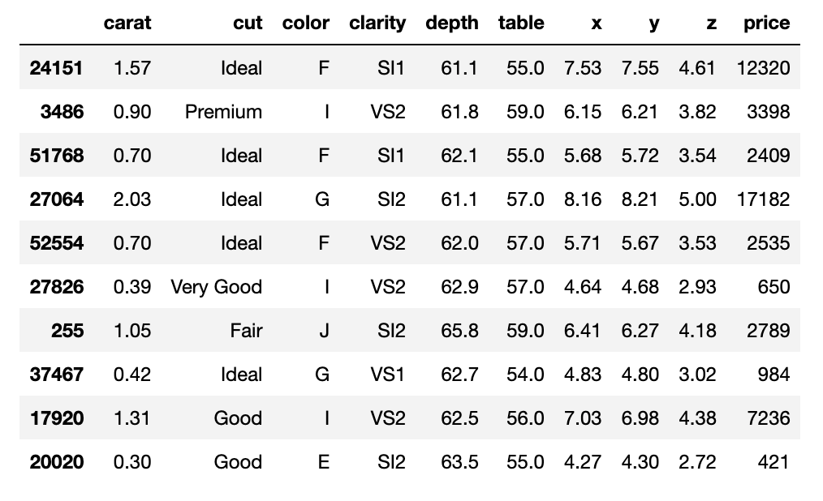
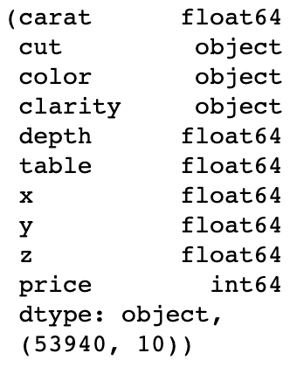
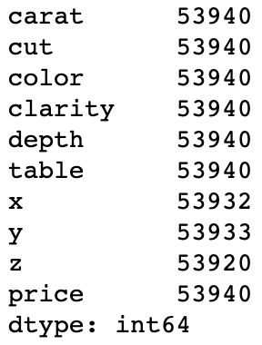
Dataset
Diamond dataset
53,940 diamond records

Slide 6
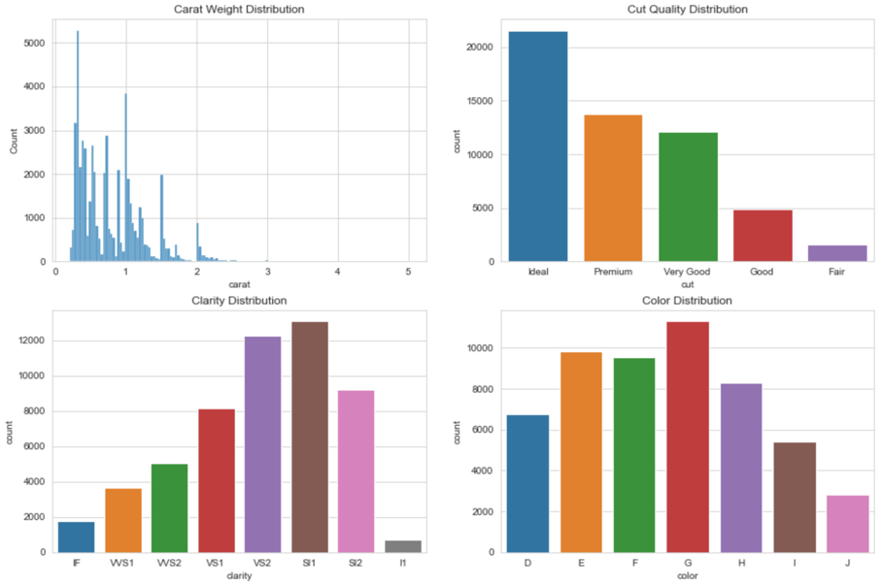
Carat, Cut, Color, Clarity
Most are >2.5 ct
High degree of cut quality
Most have inclusions
Mid-upper trench of color quality

Slide 7
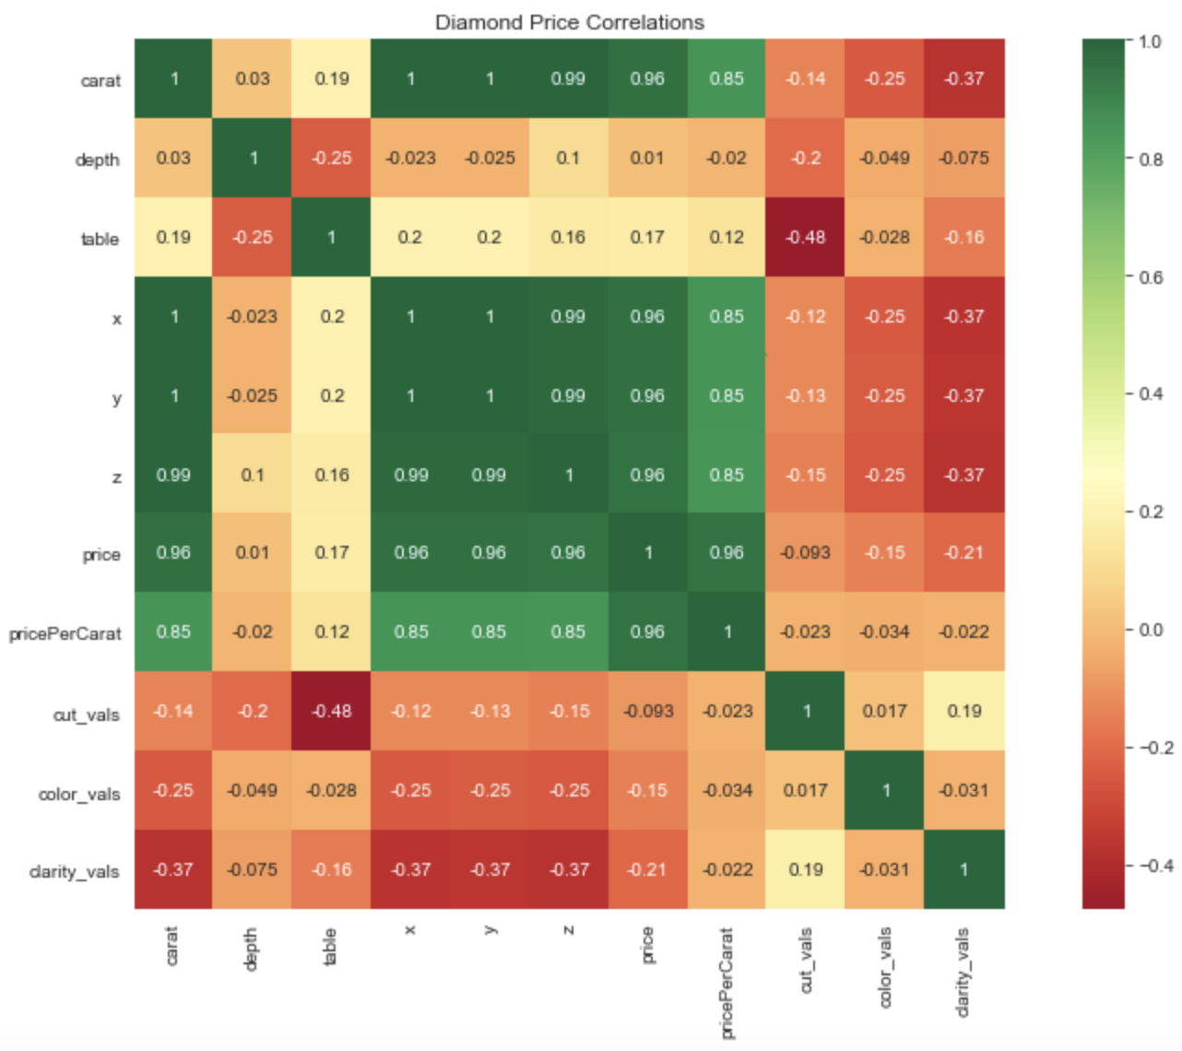
Feature Correlations
Positive Price Correlation
Carat
Dimensions (X,Y,Z)

Slide 8
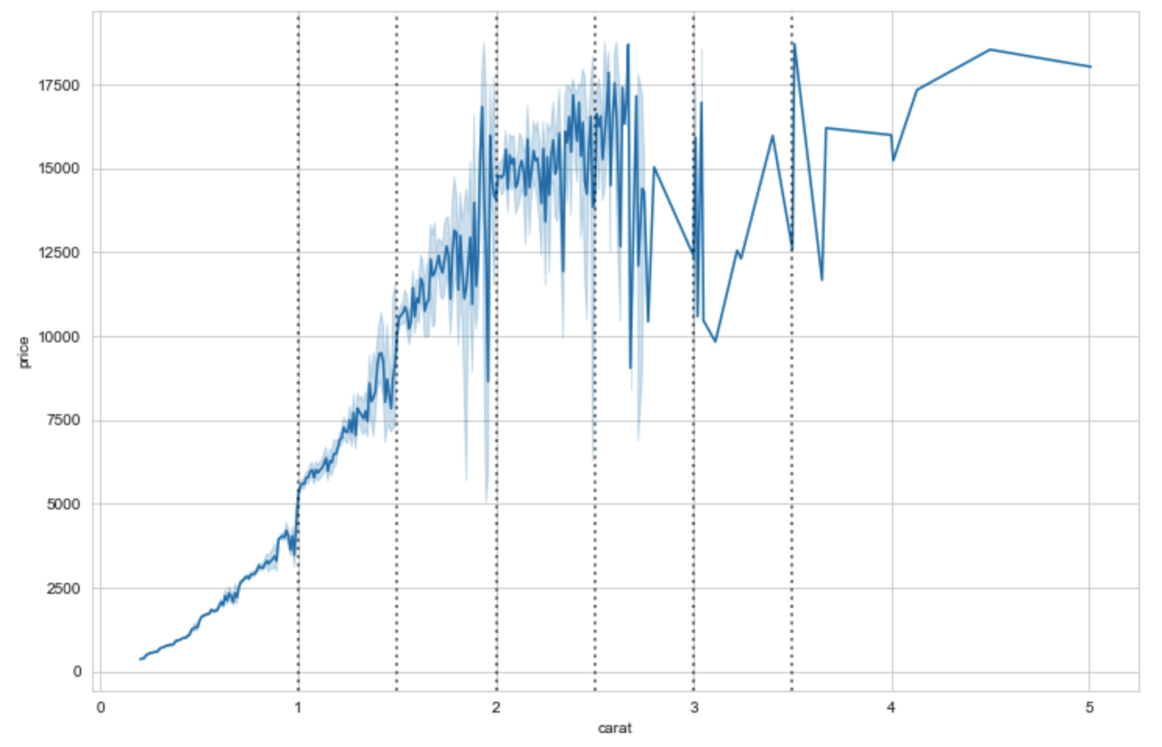
Price vs Carat
Positive correlation
Large jumps, higher price variability at 0.5ct intervals

Slide 9
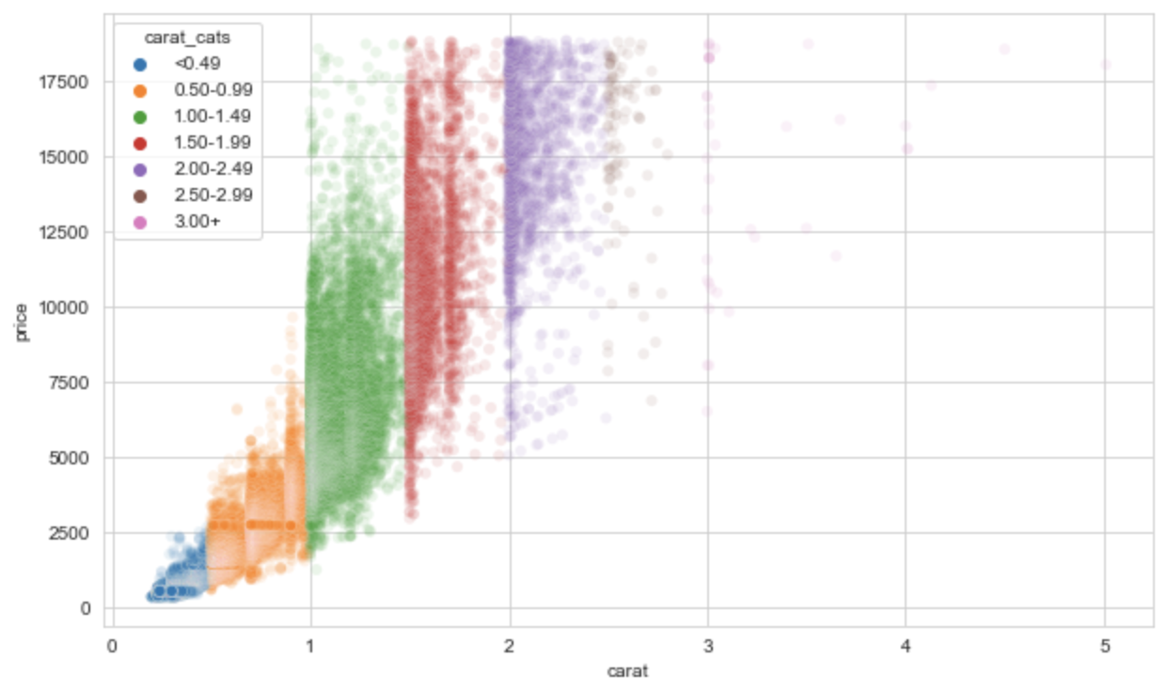
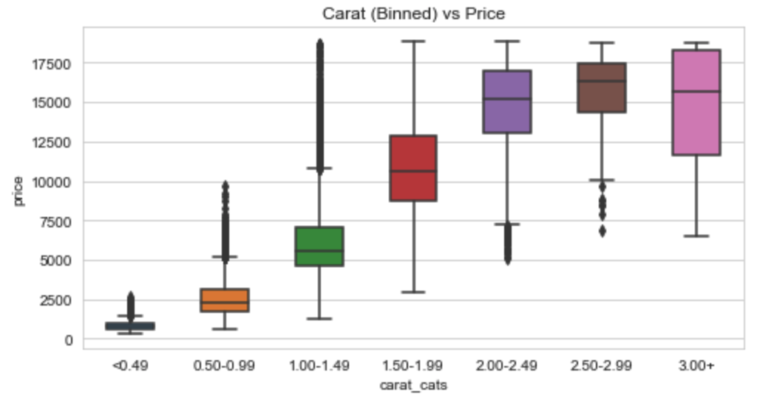
Carat Weight Intervals
Higher carat weight are top-loaded in price
Lower carat weight are bottom-loaded in price

Slide 10
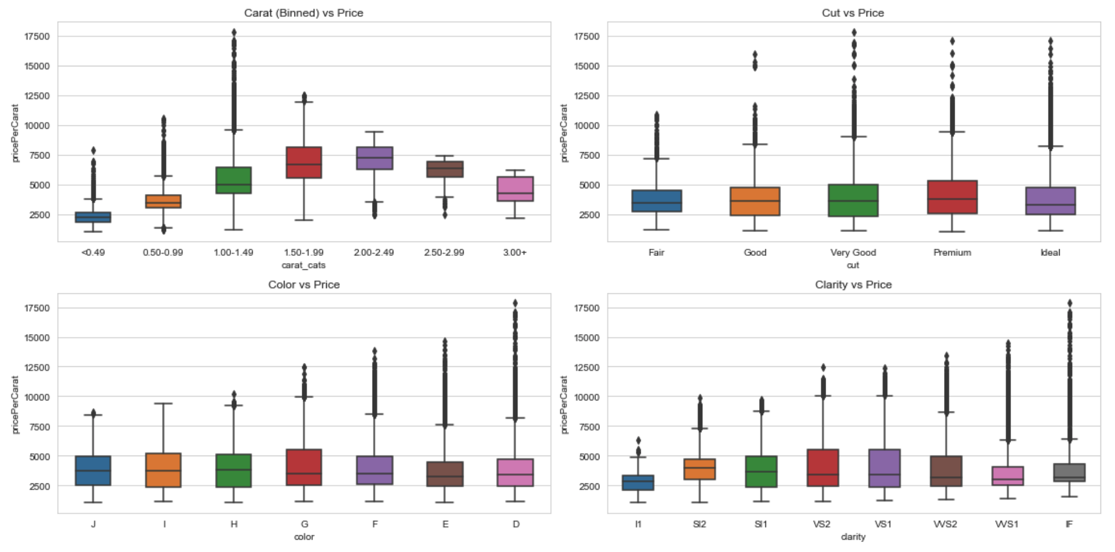
Carat, Cut, Color, Clarity

Slide 11
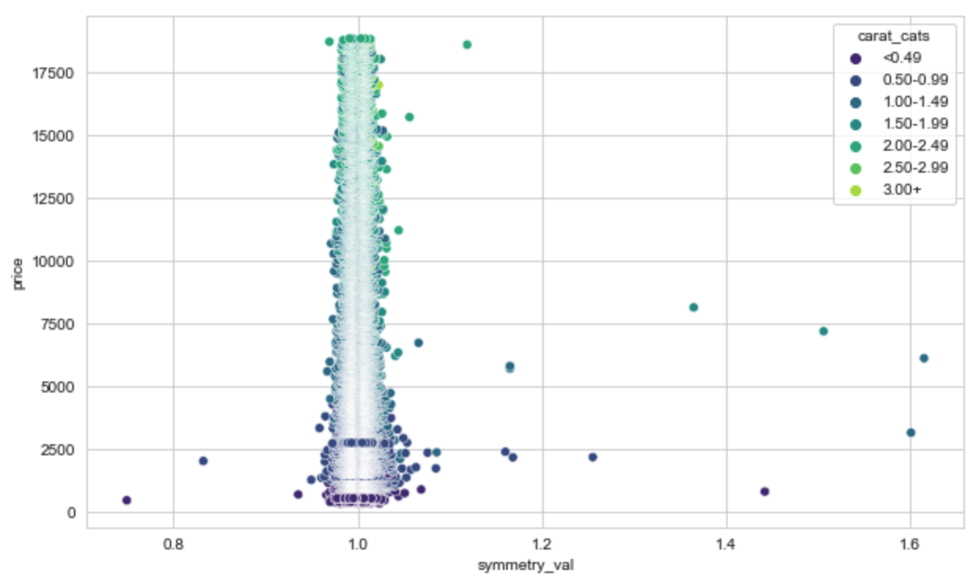
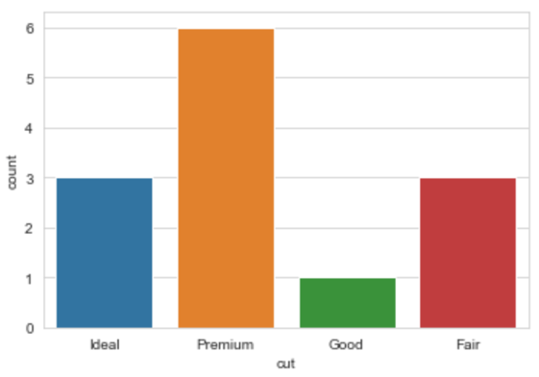
Diamond Shape
Most are symmetrical
Round diamond shape
Cut quality for outliers
Outliers are likely different shape rather than cut poorly

Slide 12
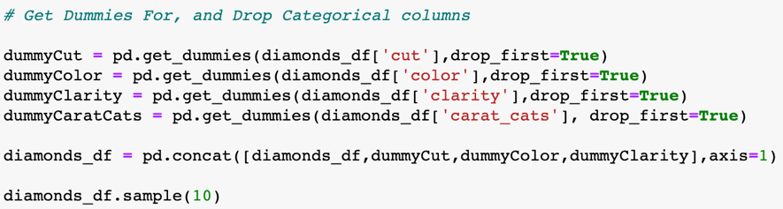
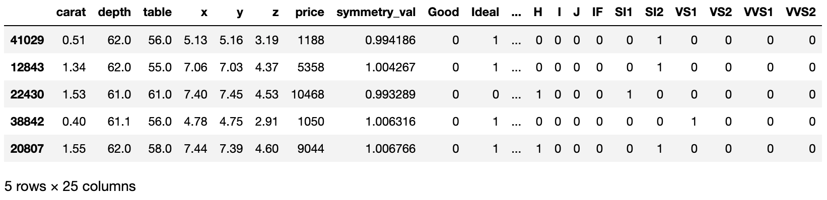
Training and Testing Considerations
Create “dummy categories” for categorical variables
Split dataset in train and test sets
Train/test split 70/30
Target column = price

Slide 13
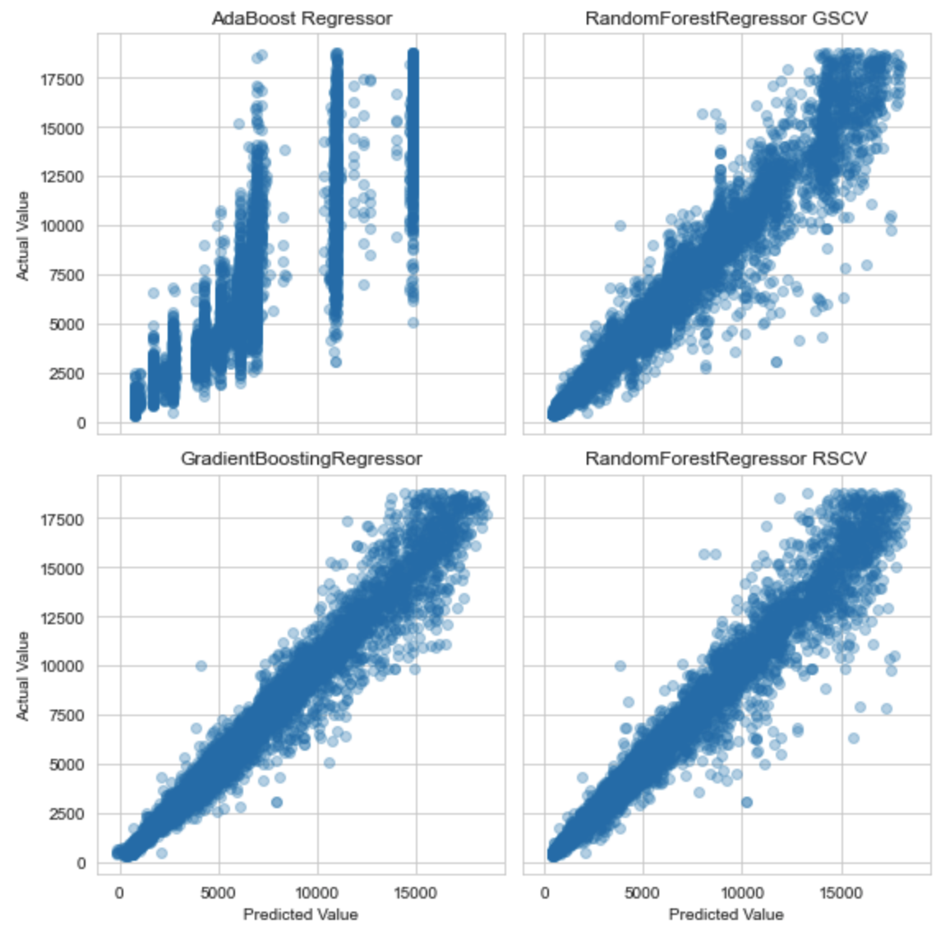
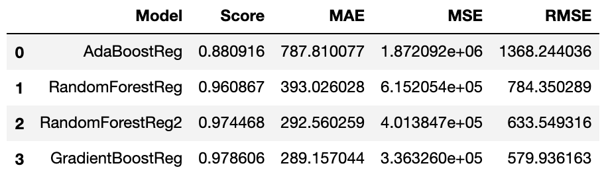
Model Development
3 Model Types:
AdaBoost Regression
Random Forest Regression
Gradient Boosting Regression
Grid Search Cross Validation
Random Search Cross Validation Test on RFR parameters

Slide 14
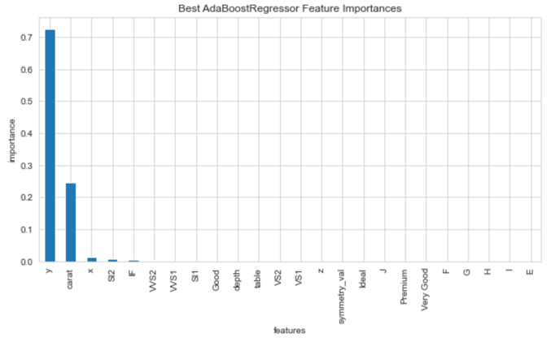
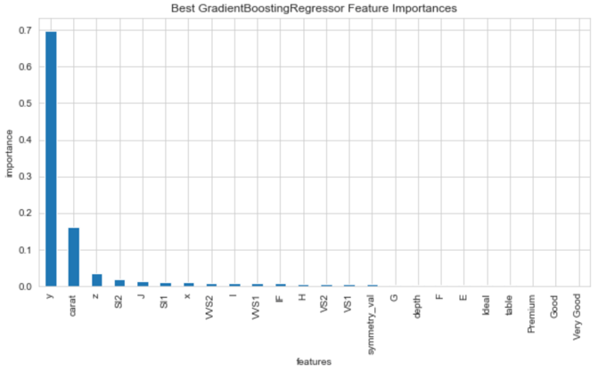
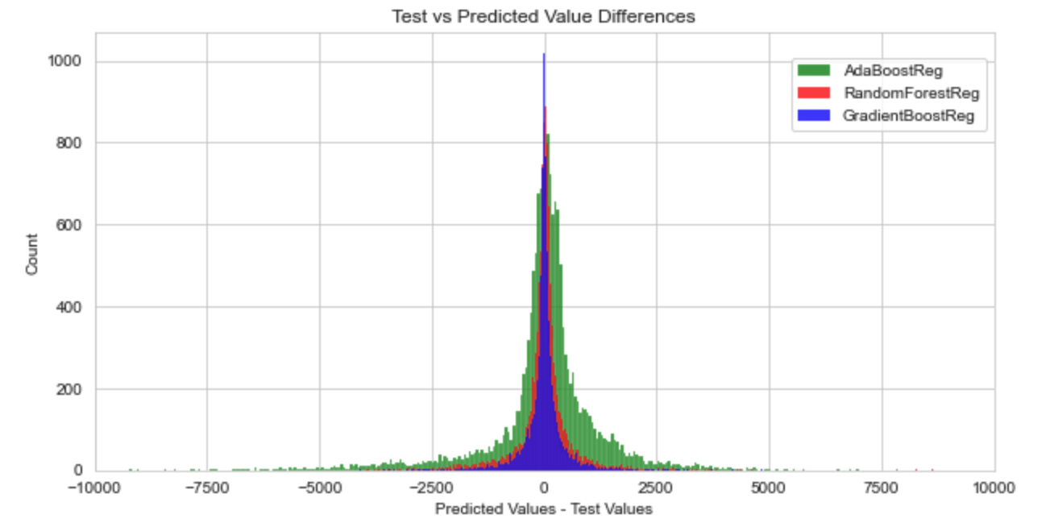
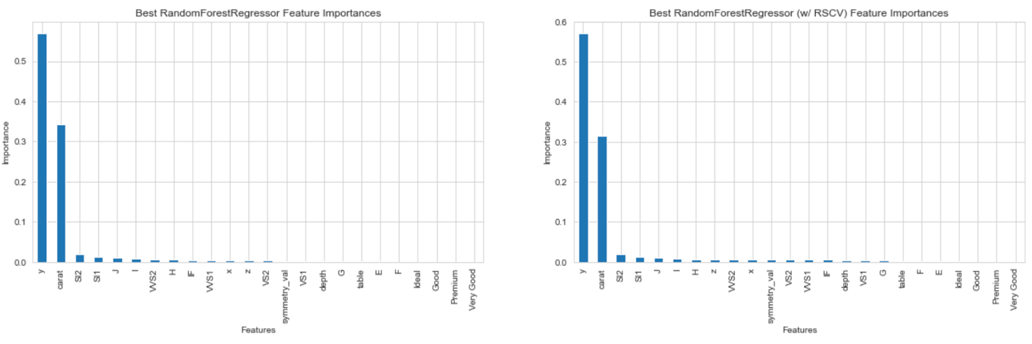
Feature Importance

Slide 15
Value Driver Tree

Slide 16
Scenario Testing
Scenario 1
Drop dimensional data (x, y, z, symmetry)
Scenario 2
Only the ”4C’s”, drop other shape specifics (table, depth)
Scenario 3
Only carat weight and high quality diamond indicators

Slide 17
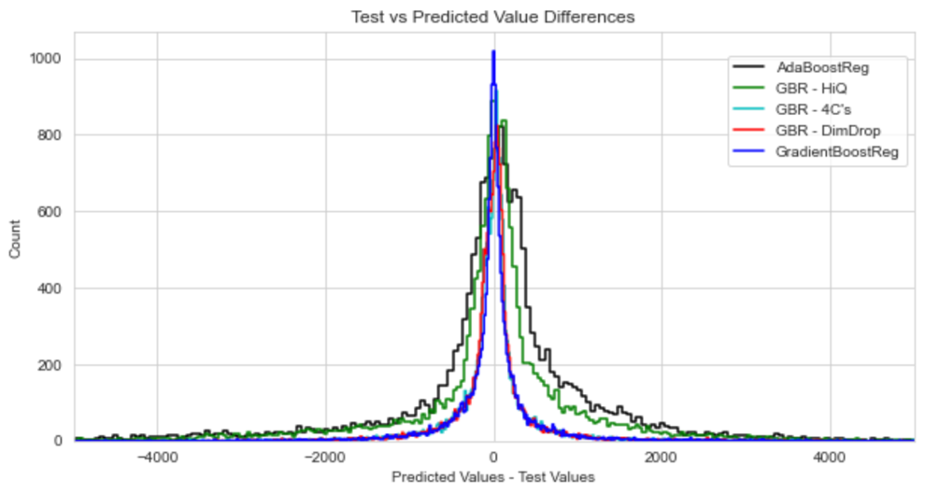
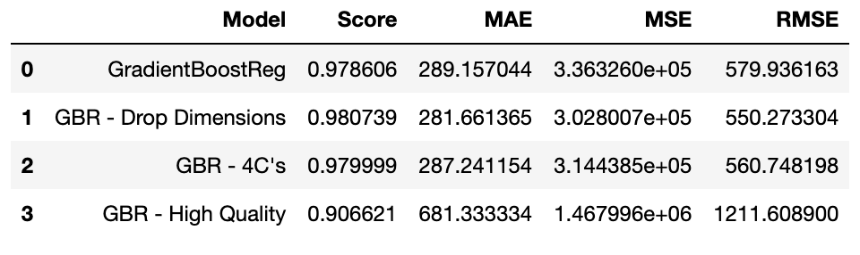
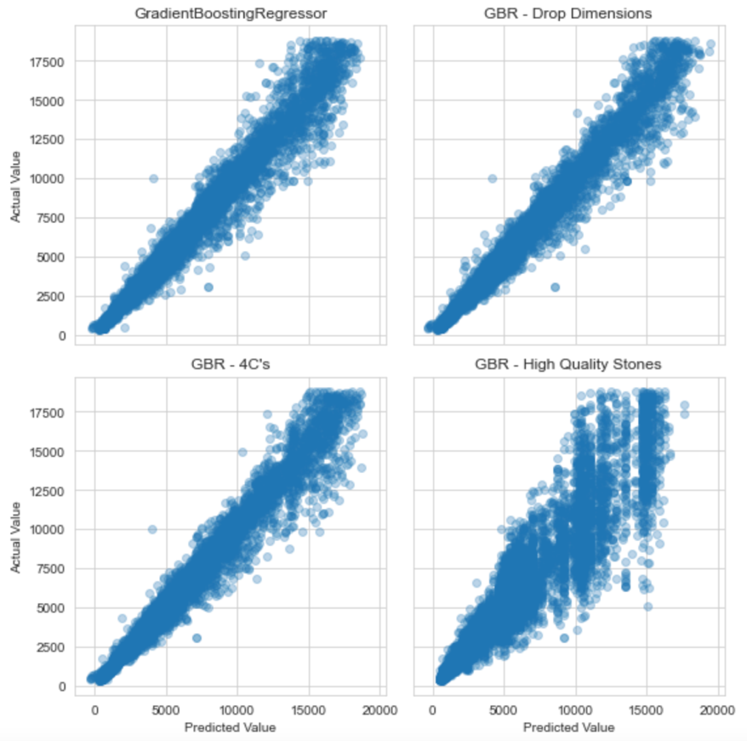
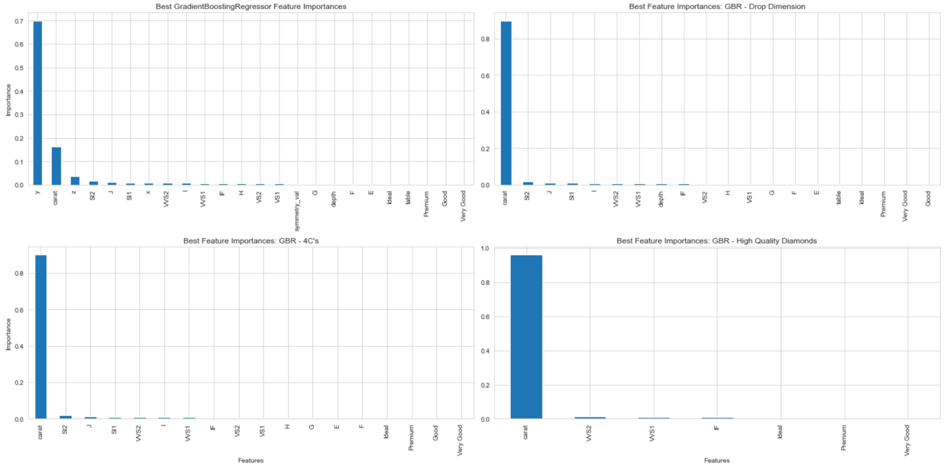
Scenario Testing Results

Slide 18
Conclusions & Recommendations
Conclusions:
Carat has the highest impact on diamond price
Other diamond characteristics describe outliers
GradientBoosting Regressor can accurately predict diamond price
Diamond retailers impacted most by the carat weight of diamonds they sell
Recommendations
Evaluate temporal price to better understand future diamond purchase costs
Evaluate supply/demand impact on diamond price

Slide 20
Value Driver Tree
Diamonds Sold
Diamond Dimensions
Quantity
X, Y, Z (in mm)
Revenue
Diamond Size
$ USD
Weight (in carats)
Diamond Features
Sale Price
Table, Depth (in percentage)
$ USD/Diamond
Price Per Carat
Diamond Cut Quality
Store Profit
$USD/Carat (Variable)
Ideal, Premium, V.Good, Good, Fair
$ USD
Diamond Clarity
Equipment Maintenance
IF, VVS1, VVS2, VS1, VS2, SI1, SI2, I1
Fixed Costs
$ USD
$ USD
OPEX
Diamond Color
Costs
$ USD
D, E, F, G, H, I, J
$ USD
Variable Costs
Diamonds Purchased
$ USD
Quantity
Cost/Diamond Purchased
$ USD/Diamond (Variable)

Slide 21
The “Four C’s” of Diamond Quality
Carat
Clarity
Cut
Colour

